Slide 1
W. S. Hornsby Middle School Title I Input/Revision Meeting
Thursday, March 9, 2023
5:00 PM
Cafeteria

Slide 2
Notes:
This is our strategy map where our ultimate goal is student achievement and success.

Slide 3
Notes:
We always refer to our vision and mission

Slide 4
Welcome Parents, School Staff, and Community Members
W. S. Hornsby Middle School receives money from Title I, Part A of the Elementary and Secondary Education Act, most recently reauthorized as the Every Student Succeeds Act.
This law provides federal funds through the Georgia Department of Education to school systems based on high numbers or percentages of children who meet certain financial criteria.
These funds are provided to help ensure that all children have an equal opportunity to succeed in school by meeting the challenging State academic content and student academic achievement standards.”
Notes:
We encourage you to ask questions throughout the meeting. We value your input! We want to make sure you leave the meeting informed about the Title I program, as well as the opportunity to provide feedback.” Have parents to complete these surveys prior to leaving the meeting.
Mcallister

Slide 5
Purpose of Meeting
“The federal law requires that each school system receiving “Title I, Part A funds” jointly develop with parents and stakeholders of all participating children.
Assistance is requested in planning our family engagement activities and specifically in revising district and school policies, School Improvement Plan, School-Parent Compact, Building Staff Capacity (determining what training our staff needs to promote good school-family partnerships, and determining how best to spend our family engagement funds).
Topics are covered in a way to provided an opportunity to ask questions, offer suggestions, and participate in more detailed discussions.
Notes:
We encourage you to ask questions throughout the meeting. We value your input! We want to make sure you leave the meeting informed about the Title I program, as well as the opportunity to provide feedback.” Have parents to complete these surveys prior to leaving the meeting.
Mcallister

Slide 6
Annual Parent and Family Engagement Evaluation
“Each year, W. S. Hornsby Middle School conducts an annual evaluation to ask parents to help us determine the effectiveness of the parent and family engagement program in improving the academic quality of the Title I schools, including identifying possible barriers to greater participation of parents in activities and programs.
Additionally, school systems will use the findings from the annual evaluation to design evidence-based strategies for more effective family engagement and to revise the Title I parent and family engagement policies.”
Notes:
We encourage you to ask questions throughout the meeting. We value your input! We want to make sure you leave the meeting informed about the Title I program, as well as the opportunity to provide feedback.” Have parents to complete these surveys prior to leaving the meeting.
Mcallister

Slide 7
State of Title I Part A, Parent and Family Engagement-Review and Revision
We will review the following:
LEA Policy (district)
School Involvement Policy
School-Parent Compact
School Improvement Plan Goals
Parental Involvement Budget
For each item, PROVIDE YOUR FEEDBACK.
Write your suggestions on the input form as the documents are discussed
Remember, you have a voice at our school, USE IT!!

Slide 8
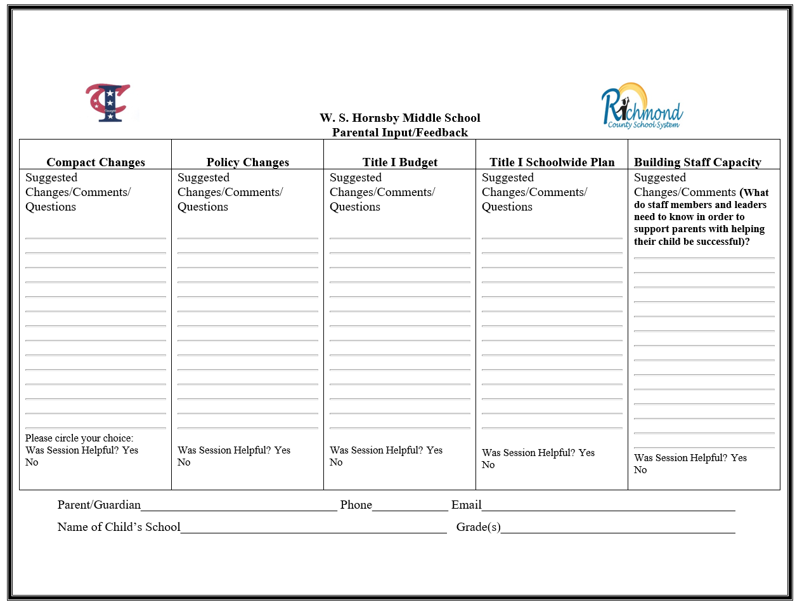
FEEDBACK
FORM

Slide 9
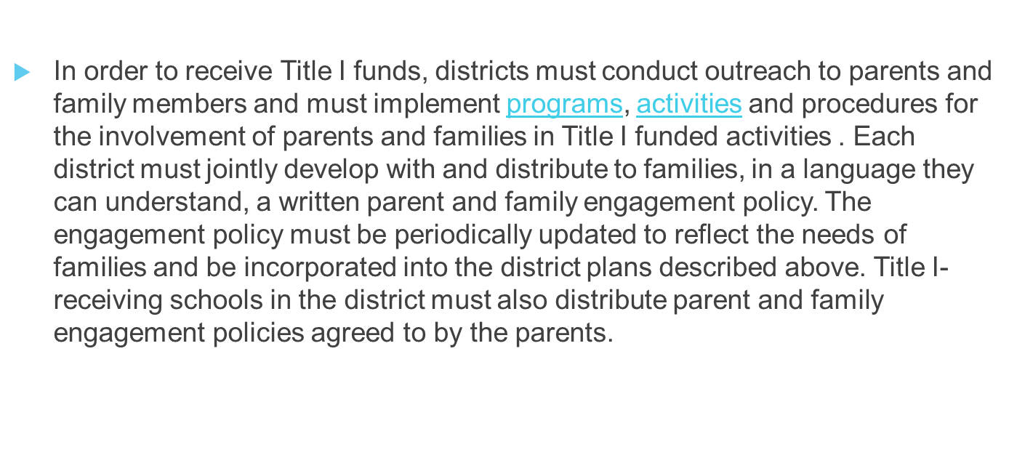
Parent and Family Engagement Policies (LEA & Schools)
Notes:
– Suggested language, “This plan describes how the school will carry out its obligation to conduct outreach and provide activities, programs, and procedures to all parents of Title I students. Based on federal law, the Georgia Department of Education requires that the plan must include, at a minimum, the following
Johnson

Slide 10
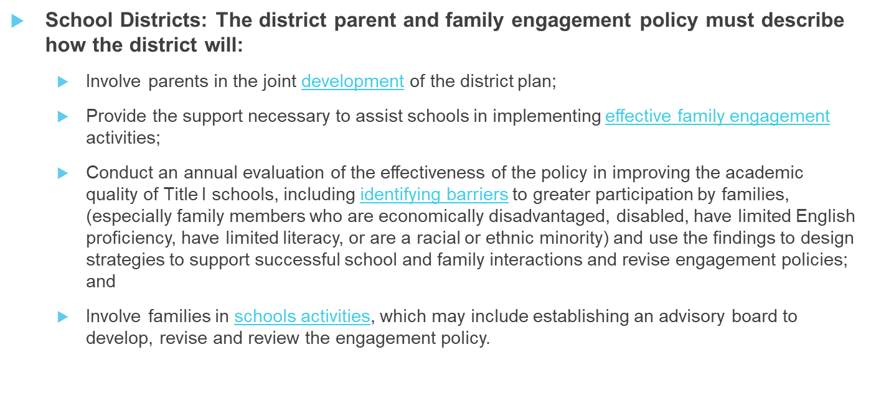
LEA PARENT AND FAMILY ENGAGEMENT POLICY
Notes:
– Suggested language, “
This plan describes how the school will carry out its obligation to conduct outreach and provide activities, programs, and procedures to all parents of Title I students.
Johnson

Slide 11
District Policy Input
DISTRICT POLICY INPUT
Can be found on the School Webpage : Parents, Title I
What changes do you suggest?

Slide 12
SCHOOL Parent and Family Engagement Policy
SCHOOL PARENT AND FAMILY ENGAGEMENT POLICY
Title I Schools:
The school parents and family engagement policy must describe how the school will:
Convene an annual meeting, at a convenient time to which all parents of low-income students are invited and encouraged to attend, to inform parents that their school receives Title I funds, that these funds come with requirements, and that parents have a right to be involved;
Offer a flexible number of engagement meetings at convenient times for families (for which the school may provide transportation, child care, or home visits using Title I funds);
Provide parents and families with:​
Information about Title I-funded programs;
An explanation of the curriculum and achievement levels the school uses; and
If requested, opportunities for regular meetings to participate in decisions relating to the education of their student.

Slide 13
School Parent and Family Engagement Policy Input
CREATION OF COMPACT & POLICY
An invitation to attend the Annual Title I Parent Forum will be sent to parents during the spring of each academic school year.
Multiple meetings will be held by the Title I Parent Designee throughout the school year with flexibility in parent scheduling.
School Compacts/School Policy will be drafted by parents in attendance at the scheduled meetings.
The drafts will be updated based on feedback from teachers, the school leadership team, and the stakeholders.
The draft will be reviewed by the Title I Program Coordinator and feedback will be provided.
A final documents with additions and corrections will be submitted to the District Title I office, posted on the school website, and sent home with all students to serve as an agreement between the school, parents, and students of the shared responsibility in continued progress of student academic achievement.
jointly develop
outline how parents, the school faculty and staff, and students will share the responsibility for improved student academic achievement.
build and develop a partnership to assist students in their academic achievement.
What changes do you suggest?

Slide 14
School Parent and Family Engagement Policy Input
ANNUAL TITLE I MEETING
We will inform them about the school’s Title I program, the nature of the Title I program, the parents’ requirements, the school parent and family engagement policy, the school-wide plan, and the school-parent compact.
Annual District Title I Meeting
Volunteer Workshop
Parent Teacher Conferences
Communication with Parents via flyers, text messages, email, website, and/or marquee
Georgia Milestones Training
Parent and Child Time Monthly Meetings
What changes do you suggest?

Slide 15
School Parent and Family Engagement Policy Input
RESERVATION OF FUNDS
If applicable, W.S. Hornsby Middle School will take the following actions to involve the parents of children served in Title I, Part A schools in decisions about how the one percent of Title I, Part A funds reserved for parent and family engagement is spent by:
Celebrating monthly academic achievement, I-Ready improvements in Reading and Math by having small celebrations with students and their families utilizing various methods of praise;
Ongoing training opportunities for faculty and staff, parent designee, parents, and administration;
Monthly training session on active parenting;
Making printing services in the parent center accessible to parents;
What changes do you suggest?

Slide 16
School Parent and Family Engagement Policy Input
BUILDING CAPACITY OF PARENTS
SHALLS OR OBJECTIVES
Providing parents with a description and explanation of the curriculum in use at the school, the forms of academic assessments used to measure student progress, and the achievement levels of the challenging State academic standards;
Materials and training to help parents to work with their child to improve their child’s achievement, such as literacy training and using technology (including education about the harms of copyright piracy), as appropriate, to foster parent and family engagement;
Providing assistance to parents of participating children, as appropriate, in understanding topics such as the following:
The challenging State’s academic standards;
The State and local academic assessments including alternate assessments;
The requirements of Title I, Part A;
How to monitor their child’s progress;
How to work with educators to improve the achievement of their child.
THEMES
Curriculum Night
Parent University (Specific Topics to Equip Parents to Help Their Children Succeed)
Financial Literacy Workshops
Progress Report Night
Report Card Night
Parent Center to check out educational material to assist in student academic achievement
What changes do you suggest?

Slide 17
SCHOOL-PARENT COMPACT
Jointly develop with parents and stakeholders- a school-parent compact that outlines how families, school, staff and students will share the responsibility for improved student academic achievement and develop a partnership to help students achieve state standards.
The compact must:
Describe the school's responsibility to provide high-quality curriculum and instruction in a supportive and effective learning environment that enables students to meet the academic achievement standards, and the ways in which each parent will be responsible for supporting learning, including volunteering in their child’s classroom, and participating in decisions relating to the education of their children;
Address the importance of communication between families and staff through, at a minimum:
parent-teacher conferences in elementary schools, at least annually, during which the compact will be discussed as the compact relates to the individual child's achievement;
frequent reports to parents on their children's progress; and
opportunities to volunteer in or observe their child's class
Ensure regular two-way meaningful communication between family members and school staff in a language they understand.

Slide 18
School-Parent Compact Input
Can be found on your School Webpage : Parents, Title I
What changes do you suggest?

Slide 19
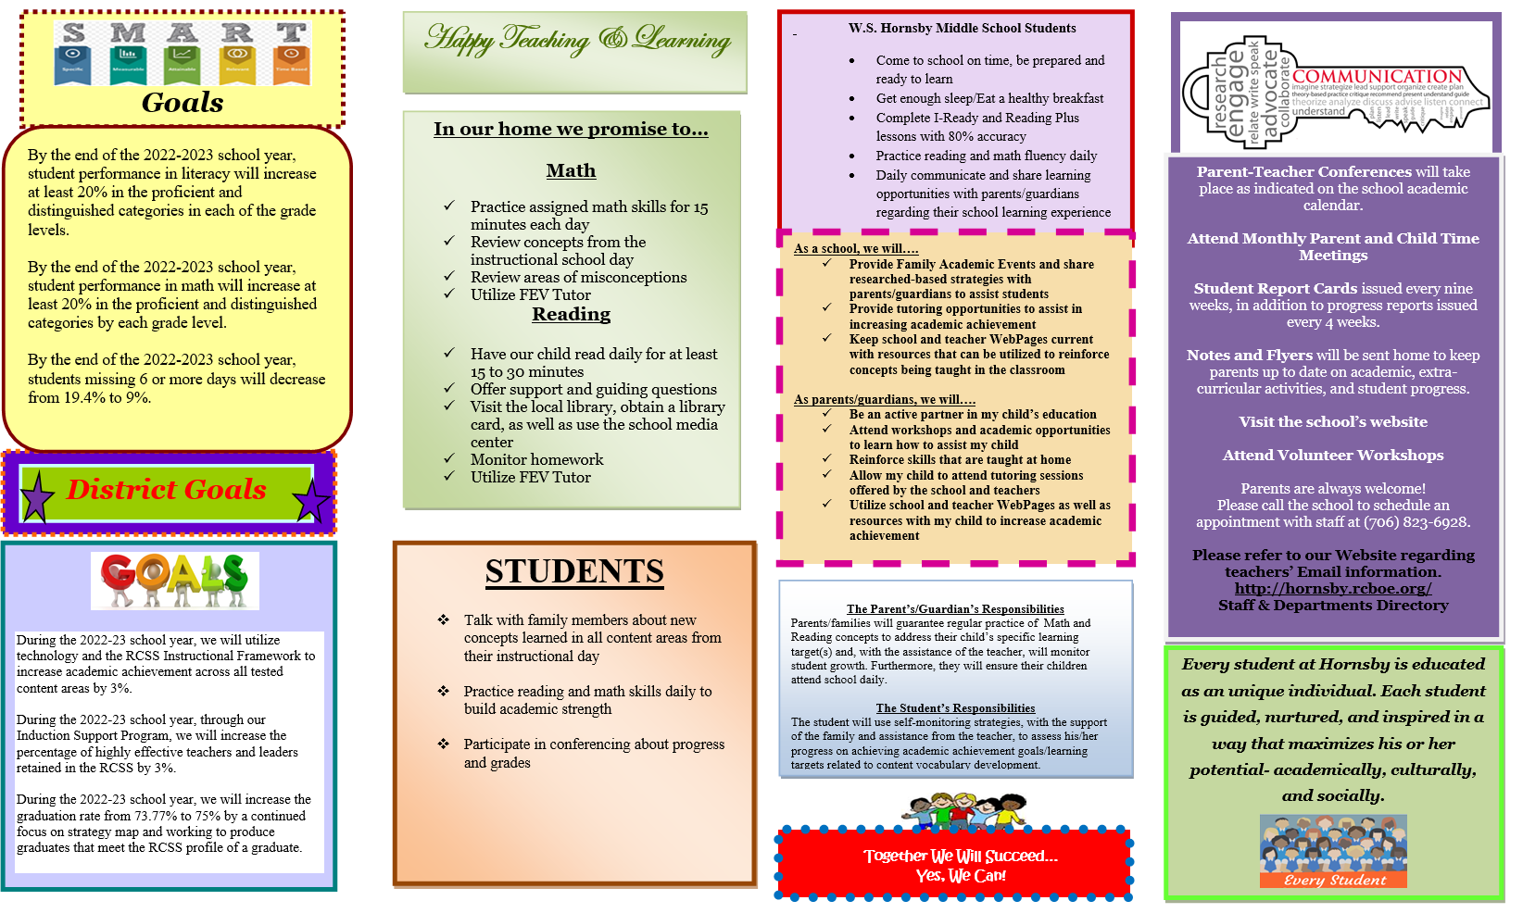
School-Parent Compact Input
Can be found on your School Webpage : Parents, Title I
What changes do you suggest?

Slide 20
School-Parent Compact Input
Can be found on your School Webpage : Parents, Title I
What changes do you suggest?

Slide 21
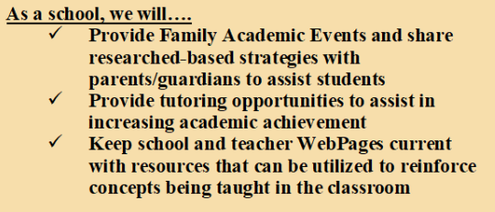
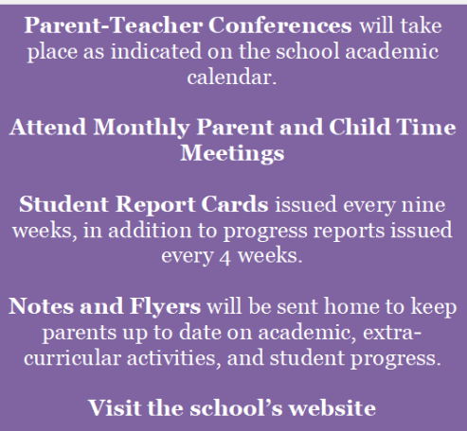
School-Parent Compact Input . . . As a SCHOOL, we will
WAYS WE WILL COMMUNICATE
What changes do you suggest?

Slide 22
School-Parent Compact Input . . . As a STUDENT, we will
The Student’s Responsibilities - The student will use self-monitoring strategies, with the support of the family and assistance from the teacher, to assess his/her progress on achieving academic achievement goals/learning targets related to content vocabulary development.
What changes do you suggest?

Slide 23
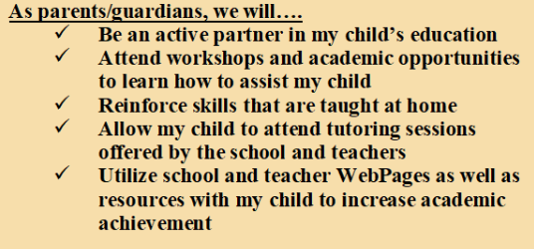
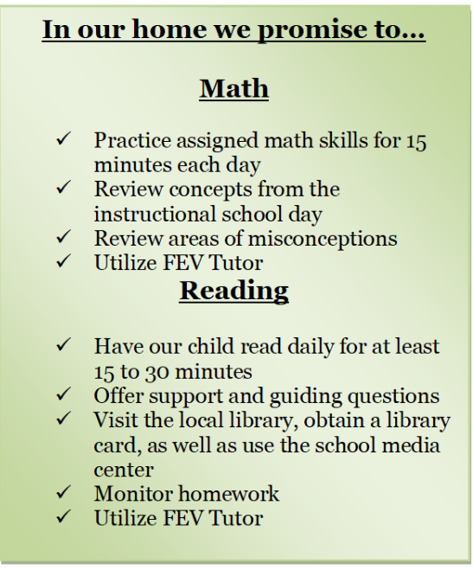
School-Parent Compact Input . . . As a PARENT, we will
The Parent’s/Guardian’s Responsibilities Parents/families will guarantee regular practice of Math and Reading concepts to address their child’s specific learning target(s) and, with the assistance of the teacher, will monitor student growth. Furthermore, they will ensure their children attend school daily.
What changes do you suggest?

Slide 24
Building Staff Capacity
Federal law also requires that Title I schools are to educate and train teachers, specialized instructional support staff, principals, other school leaders, and other staff in how to best develop partnerships with families.
Notes:
Simon

Slide 25
TITLE I FUNDS
Title I Parent and Family Engagement Set Aside:
Each district receiving more than $500,000 in Title I Part A Funds is required to reserve at least one percent of its Title I funds to carry out parent and family engagement activities, including those described in the written policy section below. Ninety (90) percent of these “set-aside” funds must be distributed to schools, with priority given to “high-need” schools. The law further requires that parents and family members of students must be included in decisions regarding how these engagement funds are spent.
Notes:
We encourage you to ask questions throughout the meeting. We value your input! We want to make sure you leave the meeting informed about the Title I program, as well as the opportunity to provide feedback.”
Jackson

Slide 26
Title 1 Parent and Family Engagement Funds Input
Technology equipment – printer
Supplies – paper, binders, chart paper, pens, markers, post-it notes
Technology supplies – printer ink
What are some suggestions for the use of Parent and Family Engagement Funds?

Slide 27
School Improvement Plan
W. S. Hornsby Middle School annually evaluates the schoolwide improvement plan using the following:
Data from state assessment/GMAS
Other student performance data – i.e. iReady, common assessments
Attendance and discipline data
Perception data
All data is used to determine if the school improvement plan has been effective in addressing the identified areas for growth, and in turn, increase student achievement
Schools must annually revise the plan, as necessary, based on student needs and the results of the evaluation to ensure continuous improvement.
(ESEA section 1114(b)(3); 34 C.F.R. § 200.26(c)).

Slide 28
SCHOOL IMPROVEMENT GOALS
What are some suggestions for goals and/or initiatives for the upcoming school year?

Slide 29
School Feedback & Surveys
Feedback forms and surveys are meant to gather information that is geared to provide feedback to improve services to provide for students and parents.
Parents have a voice in what is done in the school and when the parents respond, the school knows what direction can be taken to achieve the maximum compatibility between home and community.
Please turn in your feedback form tonight. If you know someone that is not here tonight, there will be a survey posted on our website under Parent/Title I,
Notes:
We encourage you to ask questions throughout the meeting. We value your input! We want to make sure you leave the meeting informed about the Title I program, as well as the opportunity to provide feedback.” Have parents to complete these surveys prior to leaving the meeting.

Slide 30
Recommendations for Revisions/ Updates
The revisions / updates recommended will be
incorporated, as possible, into the appropriate documents for the upcoming school year. A final draft will be available on W. S. Hornsby Middle School
website, and will be distributed accordingly.
Please complete the brief feedback form for this meeting. We appreciate your suggestions on how to make our input meetings better. Thank you for coming!
We hope to see you again very soon!”

Slide 31
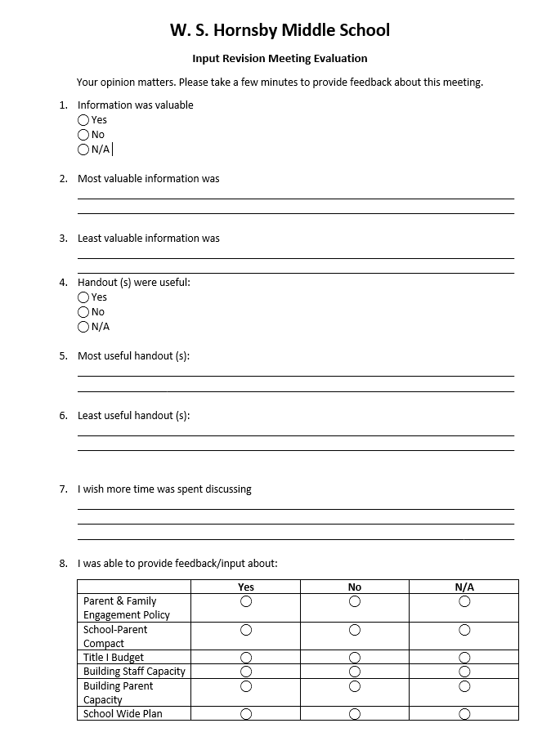
MEETING EVALUATION
Thank you for attending our meeting. Please complete the End of Meeting Evaluation Form.
Notes:
We encourage you to ask questions throughout the meeting. We value your input! We want to make sure you leave the meeting informed about the Title I program, as well as the opportunity to provide feedback.” Have parents to complete these surveys prior to leaving the meeting.
Mcallister

Slide 32
For more information or questions:
Mrs. King, Principal
(706) 823-6960
Mrs. Rehder, Parent Facilitator
(706) 823-6960
RehdeJa@BOE.richmond.k12.ga.us
Ms. Lisa Byrd, Federal Program Specialist
706-826-1134
byrdli@boe.Richmond.k12.ga.us

